Slide 1

COMMISSION
the act of committing or entrusting a person, group, etc., with supervisory power or authority.
an authoritative order, charge, or direction.
authority granted for a particular action or function.
a document granting such authority.
a document conferring authority issued by the president of the U.S. to officers in the Army, Navy, and other military services, and by state governments to justices of the peace and others.
the power thus granted.
the position or rank of an officer in any of the armed forces.
a group of persons authoritatively charged with particular functions: a parks commission.
the condition of being placed under special authoritative responsibility or charge.
[kuh-mish-uh n]
Notes:
Before The Creator created Adam, He told the Angels that He was going to create man. And the angels said ‘ are you going to create another being who is going to cause mischief on earth? The Creator told them “ I know what you know not. Then after He had created Adam He taught Adam the names of things. He then asked the angels to name the things. They couldn’t answer. Then He told Adam to tell them the name of those things….so if you are asked “ whats in a name? say “ everything”…so lets start with commission

Slide 2
A COMMISSIONER
1. A person or group committed or entrusted with supervisory power or authority.
2. A person conferred with an authoritative order, charge, or direction.
3. A person authority granted for a particular action or function.
[kuh-mish-uh n-ur]

Slide 3

The vision of the Football Federation of Belize is to be a professional, respected and efficient organization for locally and internationally recognized football, which enhances the interests of all stakeholders and contributes to the national development of Belize.
The FFB Vision

Slide 4
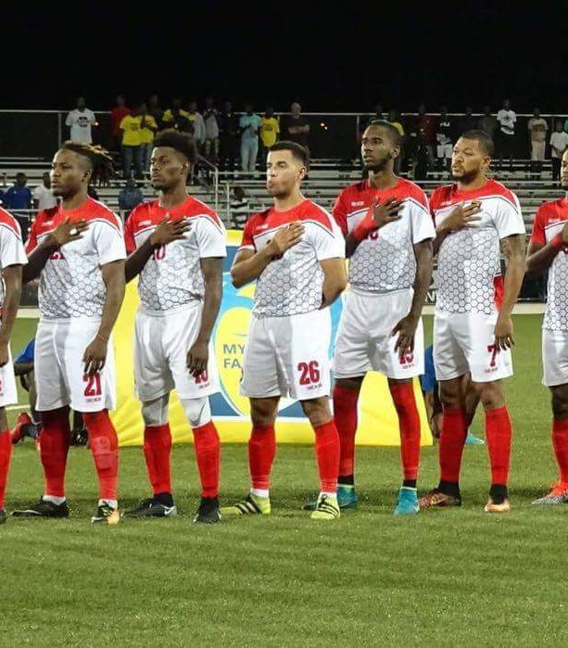

THE FFB FOOTBALL MATCH EXPERIENCE
COURTEOUS TICKET SALEPERSONS
FRIENDLY GATE PERSONNEL
COMFORTABLE,SAFE ACCOMODATION FOR SPECTATORS
AESTHETIC PRE-GAME ACTIVITY
PUNCTUAL MATCH KICK-OFFS
ACCOUNTABILITY OF ALL MATCH FUNCTIONARIES
SAFE FACILITIES FOR ALL PLAYERS AND OFFICIALS
DELIVERY OF THE BEAUTIFUL GAME PLAYED BEAUTIFULLY
A FFB THAT HOLDS ITSELF ACCOUNTABLE TO THE BELIZEAN PUBLIC
REFEREEING SERVICES DELIVERED PROFESSIONALLY
ALL PARTIES BEHAVING RESPECTFULLY TOWARDS ONE ANOTHER
PROFESSIONALISM BY MATCH COMMISSIONER IN EXECUTING HIS DUTIES

Slide 5
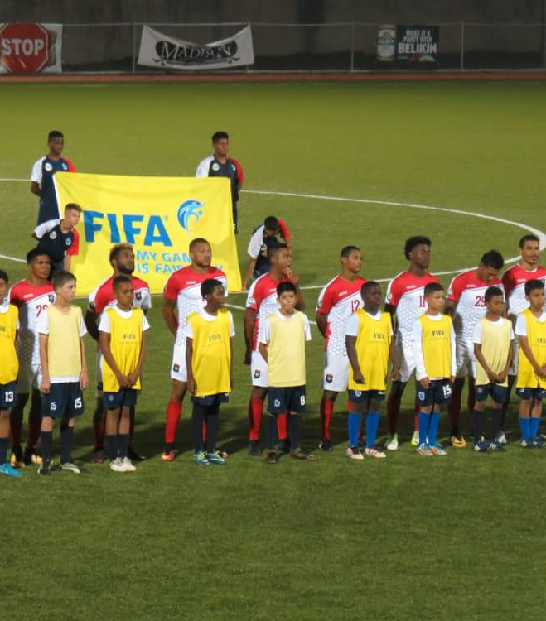
THE FOOTBALL MATCH
FIFA IS THE CUSTODIAN OF THE GAME OF FOOTBALL IN THE GLOBAL CONTEXT
FFB IS THE CUSTODIAN OF THE GAME OF FOOTBALL IN THE BELIZEAN CONTEXT
FFB PROMOTES THE GAME OF FOOTBALL THROUGH A SYSTEM OF MATCHES CALLED A COMPETITION
A COMPETITION IS THE CONFLUENCE OF FIFA, CONCACAF, FFB DIRECTIVES, CODES AND REGULATIONS AND IS DOCUMENTED IN THE FORM OF A GOVERNING SET OF REGULATIONS SIGNED BY THE FFB PRESIDENT AND THE FFB GENERAL SECRETARY ON BEHALF OF THE FFB EXECUTIVE COMMITTEE, THE HIGHEST FOOTBALL AUTHORITY IN BELIZE BETWEEN FFB CONGRESSES
ON ANY GIVEN DAY, AT A GIVEN VENUE, AT A SPECIFIED TIME A FFB ORGANIZED OR SANCTIONED COMPETITION IS REPRESENTED BY A SINGLE FOOTBALL MATCH
THIS SINGLE FOOTBALL MATCH IS SUPERVISED BY THE FFB MATCH COMMISSIONER

Slide 6
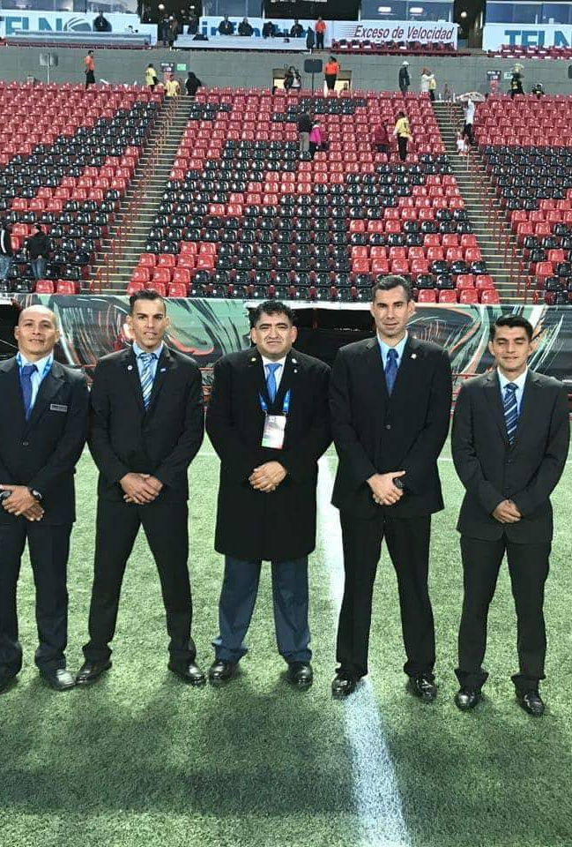
THE FFB MATCH COMMISSIONER
HAS SUPERVISIORY AUTHORITY OVER PROPER CONDUCT OF EVERY INDIVIDUAL WITHIN THE CONFINES OF VENUE WHERE A MATCH IS BEING PLAYED ( I.E. FANS, PLAYERS, REFERREES, TEAM OFFICIALS ETC )
TAKES NOTES OF EVERY INSTANCE OF IMPROPER CONDUCT ( AN INCIDENT) AND TRANSMITS THIS RECORD IN THE FORM OF AN INCIDENT REPORT IN HIS MATCH COMMISSIONER REPORT
MUST BE THOROUGHLY FAMILIAR WITH THE REGULATIONS GOVERNING THE MATCH
MUST BE KNOWLEDGEABLE OF THE LOTG IN FORCE
MUST POSITION HIMSELF WHERE HE CAN MAKE THE BROADEST OBSERVATIONAL SWEEP
MUST BE OBJECTIVE IN REPORTING ALL FACTS ARISING FROM INCIDENTS WITHIN VENUE INCLUDING WHAT HE OBSERVES OF VIOLATIONS OF LOTG BY MATCH OFFICIALS IN THE FIELD OF PLAY. HE MUST REFRAIN FROM PRESENTING HIS OPINIONS

Slide 7
THE FFB MATCH COMMISSIONER
MUST REPORT ALL INCIDENTS WITHOUT FEAR OR FAVOUR OF ANYONE
AS HE IS REPRESENTING THE HIGHEST FOOTBALL AUTHORITY IN BELIZE WITHIN THE CONFINES OF THE VENUE, HE MUST BE DRESSED APPROPRIATELY ( NO POLO SHIRTS, SHORTS, SNEAKERS, JEANS )
MUST ONLY INCLUDE DETAILS FROM REFEREE REPORT THAT HE WAS UNABLE TO OBSERVE.
PROFESSIONALISM SHOULD BE AN IMPERATIVE WHETHER HE IS SUPERVISING A PLC, NAWL, NALC, YOUTH COMPETITION MATCH.
HE MUST NOT COLLECT ANY CASH ON BEHALF OF THE ORGANIZING COMMITTEE ADMINISTERING THE COMPETITION
MUST WRITE COHERENTLY AND LEGIBLY

Slide 8
THE FFB MATCH COMMISSIONER
MUST ADHERE STRICTLY TO MATCH DAY COUNTDOWN
MATCH OVERSIGHT DUTIES COMMENCE WHEN HE ACCEPTS HIS APPOINTMENT FOR A MATCH. HE MUST REQUEST CONTACT INFORMATION OF THE REFEREES,HOST AND VISITING TEAM FROM OC. HE MUST CONTACT BOTH TEAMS AND NOTFY THEM OF HIS COMMISSION FOR THE MATCH AS WELL AS THE OFFICIATING TEAM
MUST BE AVAILABLE VIA ELECTRONIC COMMUNICATION AFTER RECEIVING MATCH PACKAGE
MUST TRANSMIT TO THE RESPECTIVE TECHNICAL OFFICER AND/OR FFB DIR. OF COMPETITIONS VIA WHATSAPP A COPY OF THE REFEREE REPORT AS SOON AS IT IS COMPLETED AND TRANSMIT A COPY OF THE COMMISSIONER’S REPORT AS SOON AS HE HAS COMPLETED IT WITHIN 48 HOURS.

Slide 9
THE FFB MATCH COMMISSIONER
MUST USE PROPER CHANNELS OF COMMUNICATIONS TO VOICE DISSATISFACTION WITH ACTIONS OF ANY FFB OFFICIAL WHO MAY HAVE VIOLATED FFB CODE OF CONDUCT OR FIFA FAIR PLAY CODE
HE MUST NOTE INSTANCES OF DISCRIMINATORY REMARKS WITHIN VENUE AND DIRECT SECURITY TO WARN PERPETUATORS TO DESIST BEFORE ORDERING SUCH TO BE EXPELLED FROM STADIUM
HE MUST BE SEATED ALONG WITH REFEREE ASSESSOR DURING MATCH

Slide 10
THE FFB MATCH COMMISSIONER
IN THE INSTANCES IN WHICH THE REFEREE OR ANY ASSISTANT REFEREE CONTINUALLY VIOLATE LOTG OR JEOPARDIZE SAFETY OF PLAYERS BY LIBERALLY MISAPPLYING LAWS RELATING TO FOULS AND MISCONDUCT, THE MATCH COMMISSIONER MUST CONSULT WITH REFEREE ASSESSOR BEFORE DIRECTING THE REFEREE ASSESSOR TO CONSULT WITH FOURTH OFFICIAL TO GET REFEREE’S ATTENTION. THE MATCH COMMISSIONER SHALL IMMEDIATELY NOTIFY THE DIR OF COMPETITIONS WHO SHALL THEN CONSULT WITH DIRECTOR OF REFEREES ABOUT AVAILABILITY OF OFFICIALS TO TAKE PLACE OF FOURTH OFFICIAL IN THE EVENT THAT THE REFEREE HAS TO BE REPLACED FOR PERSISTENT VIOLATION OF THE LOTG.

Slide 11
AT THE END OF THE DAY:
THE MATCH COMMISSIONER STRIVES TO PRESERVE THE FFB MATCH EXPERIENCE AT THE VENUE BY DILIGENTLY MONITORING DISRUPTING INFLUENCES AGAINST THE ELEVEN ELEMENTS AND TAKING APPROPRIATE ACTION TO MITIGATE THE NEGATIVE IMPACTS

